Slide 1
Leadership 1

Slide 2
Leadership
Are all managers leaders?

Slide 3
Leadership
Leadership
The ability to influence a group toward the achievement of a vision or set of goals

Slide 4
Determinants of effective leadership
Trait vs. Behavior

Slide 5
Trait theories of leadership
Big Five personality framework
O
C
E
A
N
1

Slide 6
Trait theories of leadership
Emotional Intelligence (EI)
Use own and others’ feelings effectively
1

Slide 7
Trait theories of leadership
Trait theories
1

Slide 8
Behavioral Theories
Ohio State Study
U of Michigan study

Slide 9
Behavioral Theories
Trait vs. Behavior
Selection vs. training

Slide 10
Contingency Theories
Leadership effectiveness differs in different situations
Leadership type + situation

Slide 11
Contingency Theories
Fiedler Model
Matching individual’s leadership style with situation
Predict the leadership effectiveness in a particular situation

Slide 12
Fiedler Model
Leadership
Situation
Leadership Effectiveness

Slide 13
Fiedler Model
Situation
Leader-member relations
Task Structure
Position power

Slide 14
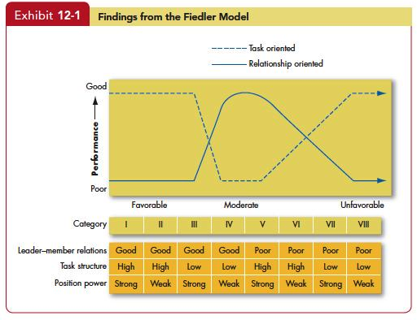
Fiedler Model
1

Slide 15
Fiedler Model
Implication

